Slide 1

Exploratory Data Analysis (EDA) on NPRI DATASET
Team- Insight Analyst (Bube, Emem, Ayo & Celine)
Course- Cmpt 2400(project 2)
Instructor- Nasimeh Asgarian
Project Topic: Based on NPRI data, which industry is predicted to have the highest growth of releases in five years? Which will have the largest decline?

Slide 2
EDA
Understanding the Data
Initial Data Preview:
Check the data structure.
Check the data types.
Check for missing values
Check for duplicates
The NPRI dataset tracks pollutant releases across Canada from 2000 to 2020, focusing on the environmental impact of industries.
Key Columns:
NPRI_ID: Unique release event ID.
Company & Facility: Identify the source.
NAICS Code: Industry classification.
Releases: Pollutants to air, water, and land.
Employees & Province: Company size and location.

Slide 3
Aligning and Merging the Dataset
Feature Engineering
Creating New Features:
Total Releases (Summed)
Years Since 2000
Prev_Year_Pollution
Growth Rate (%)
High Emission Industry
Is_COVID_Year
Region
Estimation_Method_Type
Pollution Category
Prev_Year_Category
Prev_Year_Growth
Merging: We combine two datasets (df_releases and df_disposals) using common identifiers like company name, location, and substance, ensuring all related data is brought together.
Outer Join: We keep all data from both sources, even if some information is missing from one.
Combining Columns: We merge two "Number of Employees" columns into one, using values from both sources when needed.
Cleaning: After combining, we remove unnecessary columns to make the dataset cleaner and easier to work with.

Slide 4
Feature Encoding
Standardization/Scaling
Why Standardization (Using StandardScaler) Was Appropriate
Features Have Different Units and Ranges
The dataset includes features like:
Total Releases (Summed) in tonnes
Prev_Year_Pollution in large numeric scales
Years Since 2000 in small values
Standardization brings all these features to a common scale, making them comparable without losing their patterns.
Feature Encoding:
We applied Label Encoding to certain
columns, which converts categorical data (like "Region" or "Province") into numeric labels.
This helps machine learning models understand categorical data by assigning each category a unique number.
Encoding the Pollution Category: We also convert the "Pollution Category" into numerical values, where:
Low = 1, Medium = 2 and High = 3
This makes it easier to predict pollution levels using machine learning models.

Slide 5

Model Selection Strategy
Phase 1:
Classification – Categorizing Pollution Levels
Objective:
Classify each record into one of the following pollution categories: Low, Medium, or High.
Model:
Random Forest Classifier
Why This Model?
Handles both numerical and categorical features well.
Robust to outliers and missing values.
Performs well on imbalanced and complex datasets.
Provides feature importance, aiding explainability for stakeholders.
Phase 2:
Regression – Forecasting Pollution Trends
Objective:
Predict future pollutant release trends over time for each industry using historical NPRI data.
Model:
Linear Regression
Why This Model?
Simple and interpretable — shows apparent annual growth or decline per industry.
Ideal for smaller datasets (e.g., 22 years per industry).
Efficient and scalable across multiple industry time series.
Easy to explain to non-technical stakeholders and policy decision-makers.
Enables trend comparison across industries using slope (growth rate).

Slide 6
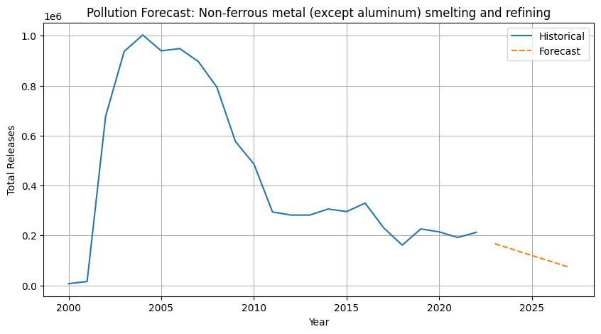
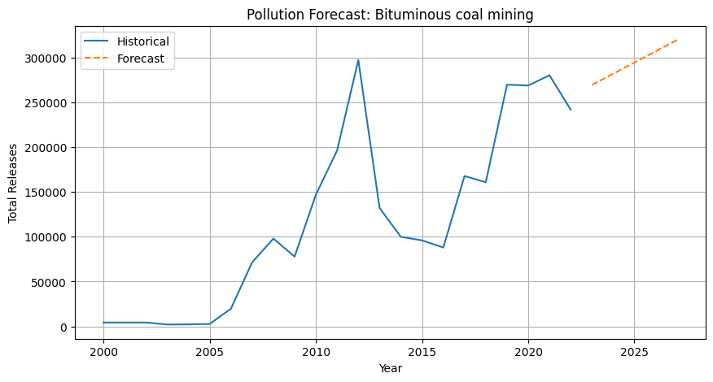
Visualizing Key Findings

Slide 7
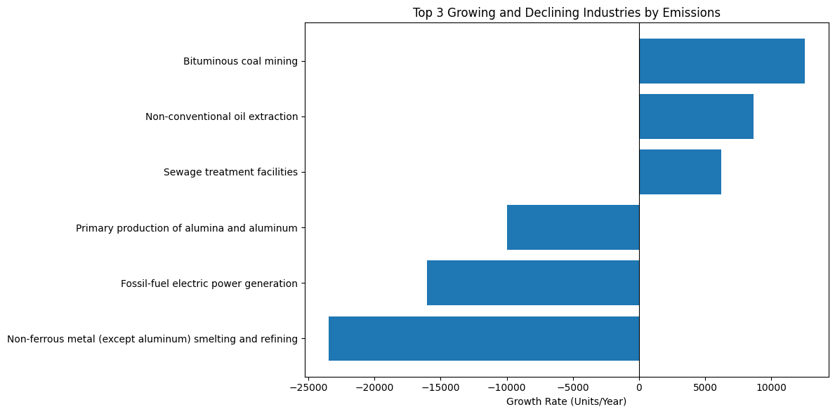
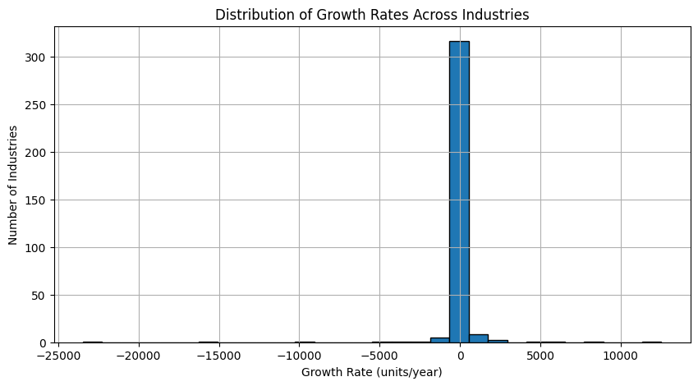
Visualizing Key Findings

Slide 8
Conclusion: Pollution Trends Forecasting Using Time Series Regression
Project Summary:
We analyzed and modeled historical pollutant release data from NPRI to forecast future emissions by industry.
The approach was divided into two phases:
Phase 1: Classification of pollution levels (Low, Medium, High).
Phase 2: Time series regression to predict long-term emission trends.
Key Findings:
Bituminous coal mining is projected to show the highest growth in emissions over the next 5 years.
Non-ferrous metal smelting (except aluminum) is forecasted to have the steepest decline, reflecting progress in emissions control.
Most industries show stable trends, but a few outliers are driving significant environmental impact.
Implications:
Forecasting tools like this can support evidence-based policy decisions and help prioritize high-risk industries.
Targeted interventions in growing sectors may prevent future environmental degradation.
Industries with successful declines can serve as benchmarks for best practices.

Slide 9

THANK YOU.

